Slide 1
Infinite series Session 23-24
Course : Calculus I
Year : 2015

Slide 2
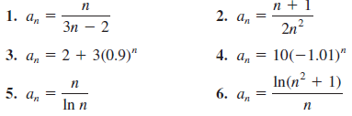
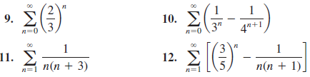
Determine whether the sequence with the given n-th term converges or diverges. If it converges, find the limit.
Find the sum of the series

Slide 3
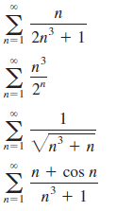
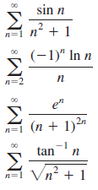
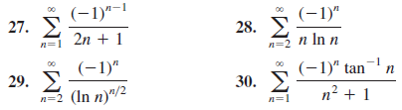
Determine whether the series is convergent or divergent.
Determine whether the series is absolutely convergent, conditionally convergent, or divergent.

Slide 4
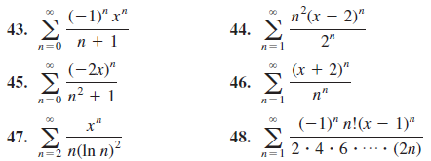
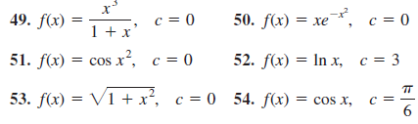
Find the radius of convergence and the interval of convergence of the power series.
Find the Taylor series of f at the given value of c.

